Slide 1
Presentation Video - YouTube link
https://youtu.be/4mnEmJtHLJg

Slide 2

Helping those that
Hurt the Most
Group High 5
York U SCS - Introduction to Big Data

Slide 3
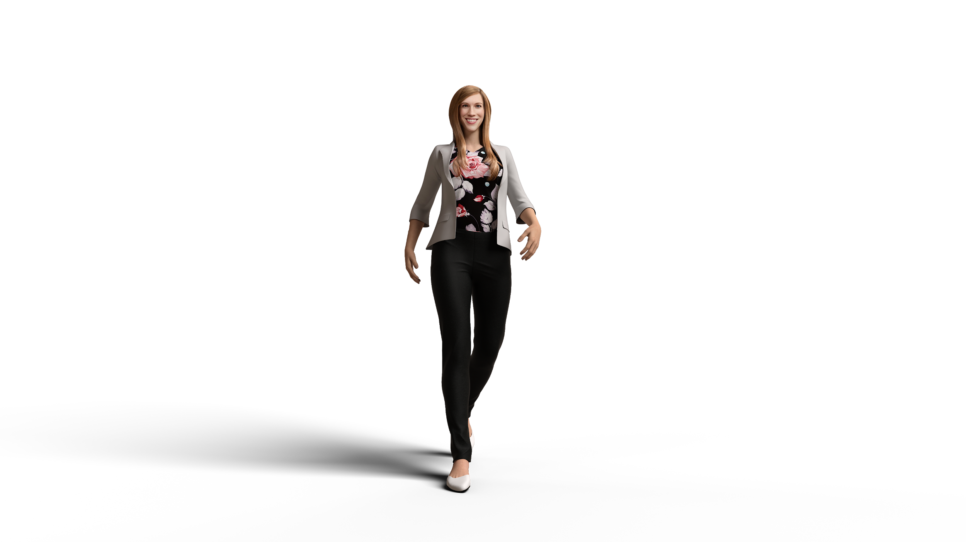




Team High 5
Shakil
April
Gary
Hari
Business Analyst
Research Analyst
Zaid
Business Intelligence Analyst
Data Analyst
Data Scientist
.py
Notes:
Hari will be added - Get picture from profile and

Slide 4

Table of Contents
Introduction
Competitive Analysis
Business Problem
Analytical Problem
Data Cleansing & Dashboards
Data Exploration
Data Analysis
Interpretation of Analysis
Findings & Recommendations
Cost/Benefit Analysis
Conclusion

Slide 5


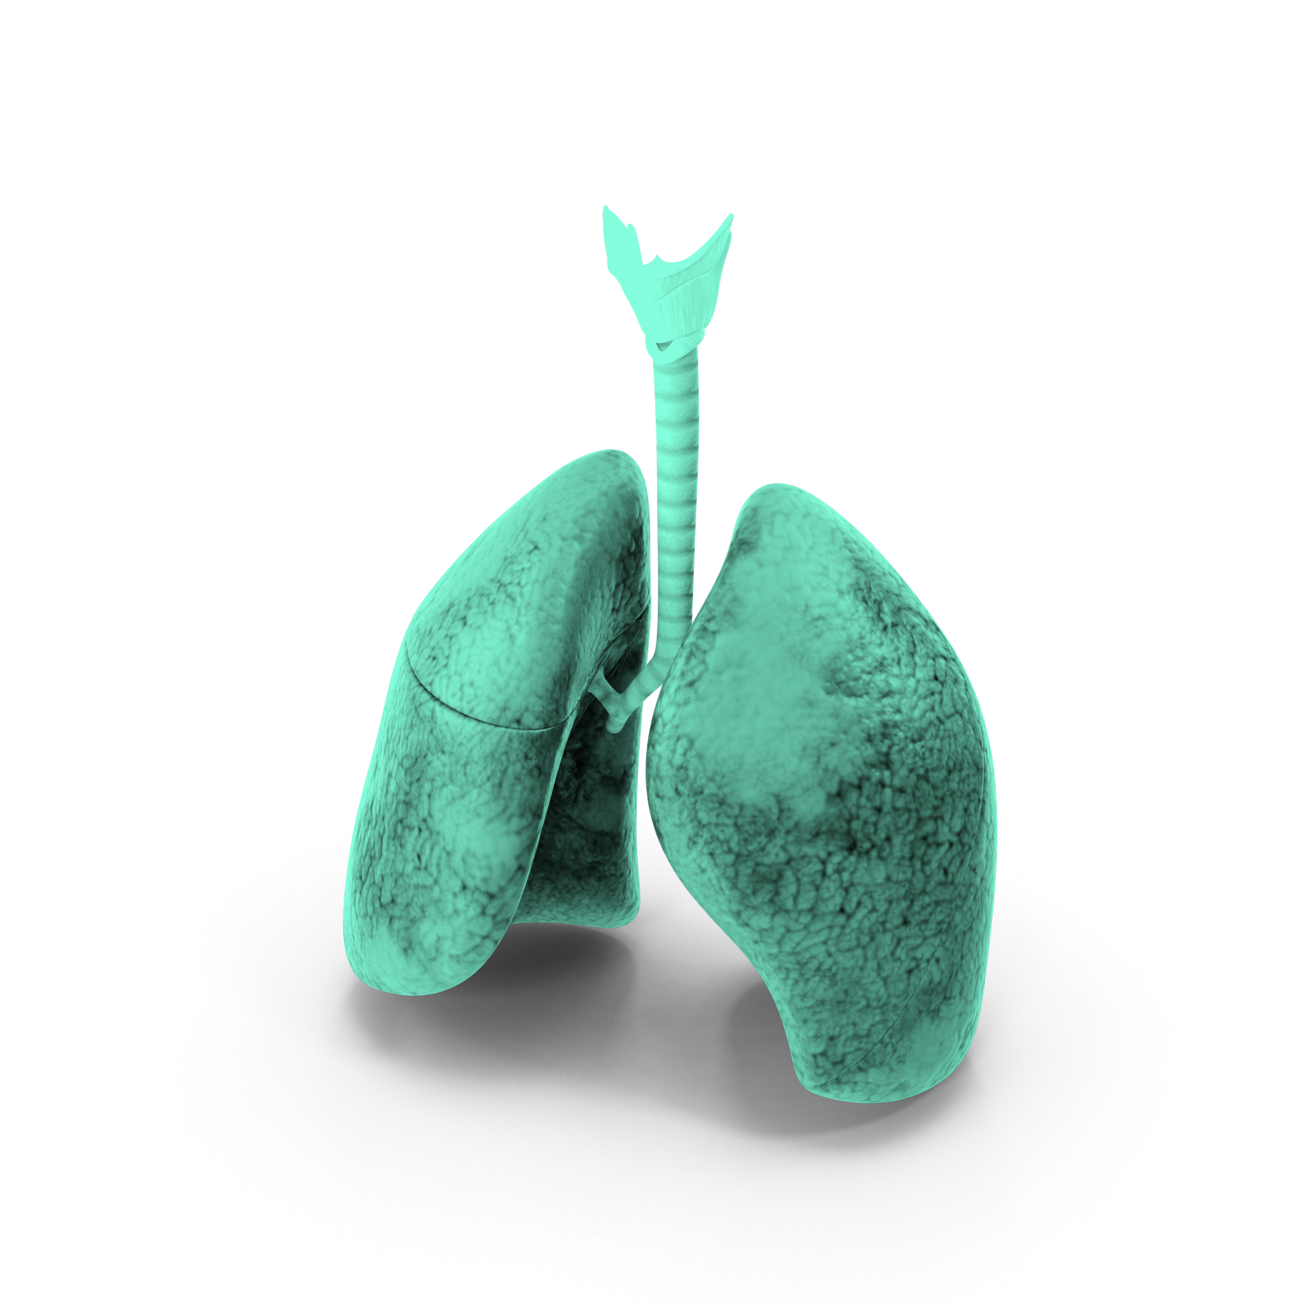
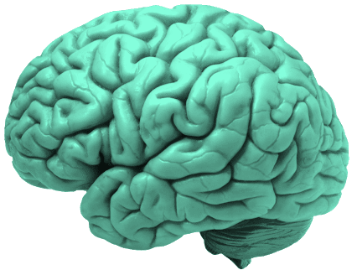
Introduction
USA Spent $3.25 Trillion in 2017 on Healthcare
32% of USA’s working population under medical debt
Americans donated $42.6 Billion for healthcare
Notes:
Business Understanding Phase: Determine Business Objectives
Background
Business Objectives
Business Success Criteria

Slide 6
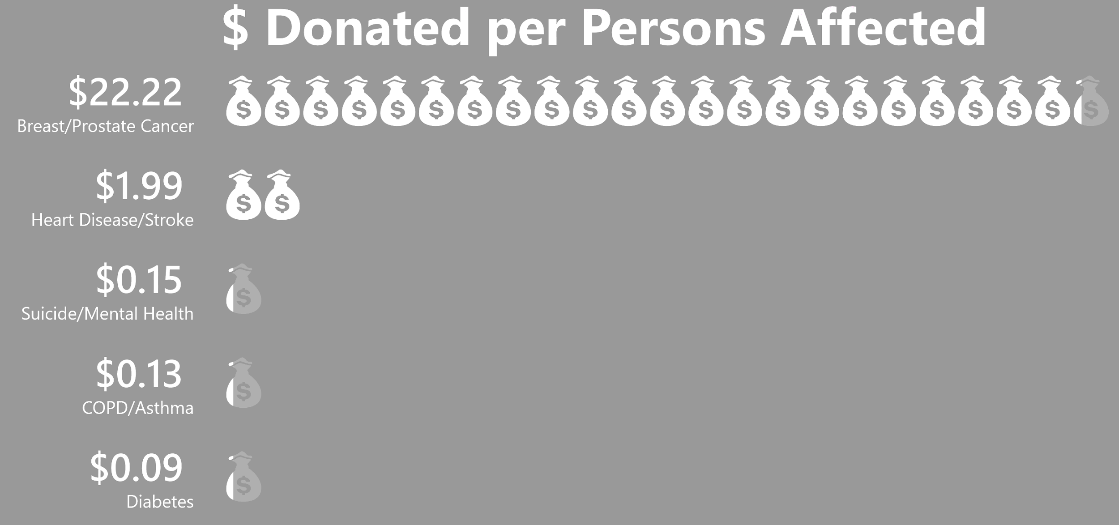

Competitive Analysis
Breast/Prostate Cancer
Heart Disease / Stroke
Suicide / Mental Health
COPD / Asthma
Diabetes
Notes:
Business Understanding Phase: Assess Situation
Resources Inventory
Requirements Assumptions, Constraints
Terminology: CDC website describes terminology (they posted our data in data.gov)
Risks & Contingencies
Costs & Benefits

Slide 7

Business Problem
Scenario: Our client is a US-based big-ticket investor / grants organization, looking to donate to and fund charitable health organizations to generate maximum positive impact on societal health
Business Question: Which diseases and/or predictive factors should the client focusing on when choosing health charities to fund?
Notes:
April to work - done
Data Understanding:
Collect: Data.gov
Describe: CDC website describes method used, we can talk about age/crude based sampling, refer to “Sampling Concepts” slide
Explore (Classification: since we have labelled data, Methods could be used Decision trees and Bayesian classifiers)
Verify Data Quality

Slide 8
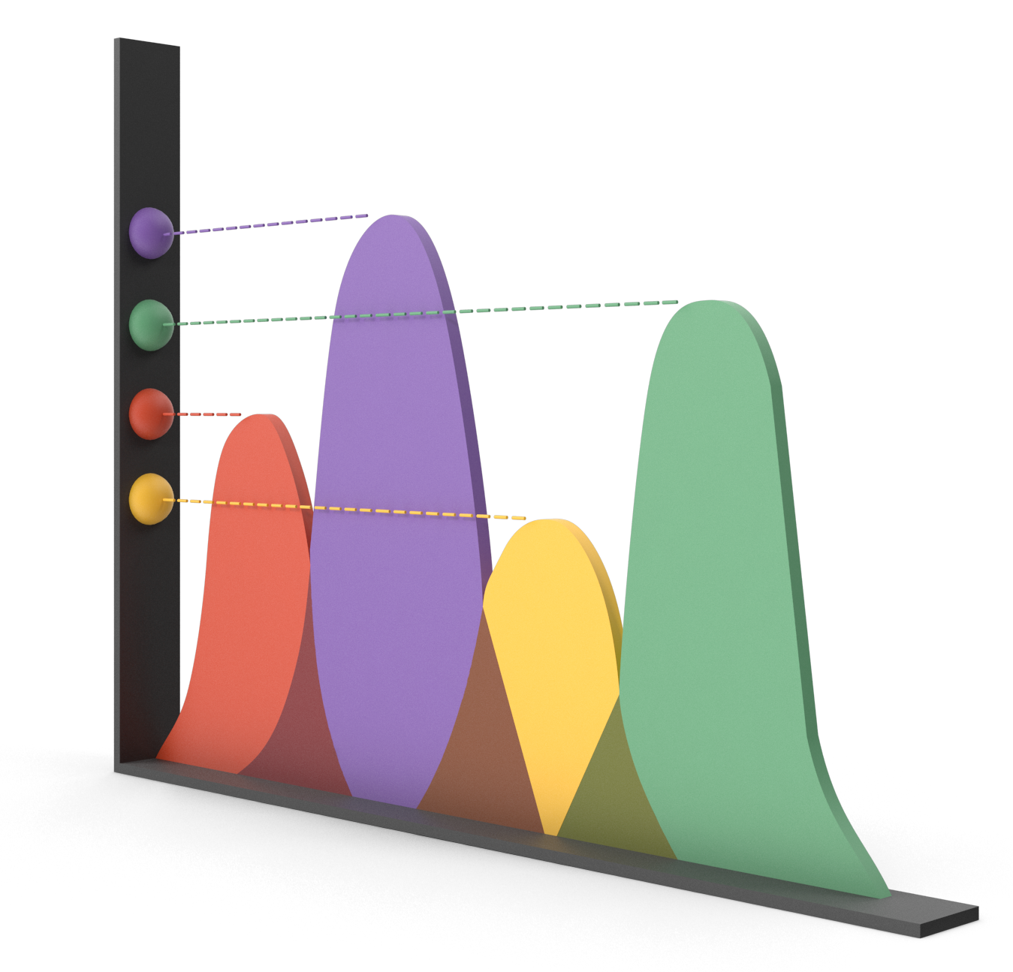
Analytical Problem
1. Identify the top diseases based on the most expensive chronic diseases for healthcare payers
2. Identify the top predictors (risky behaviours and preventative measures) across these top diseases using correlation and regression.
Notes:
April to work - done
Data Understanding:
Collect: Data.gov
Describe: CDC website describes method used, we can talk about age/crude based sampling, refer to “Sampling Concepts” slide
Explore (Classification: since we have labelled data, Methods could be used Decision trees and Bayesian classifiers)
Verify Data Quality

Slide 9


Dataset
500 Cities Dataset - CDC
Almost 500 US Cities
13 diseases
9 preventative measures
5 unhealthy behaviours
Measure = prevalence

Slide 10
Data Cleansing and Initial EDA

Slide 11
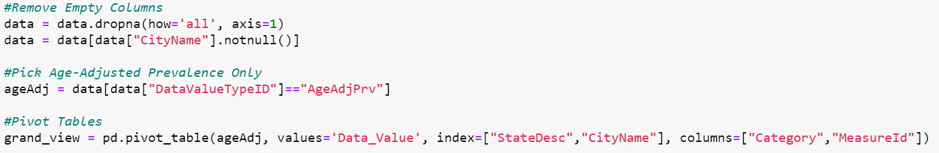
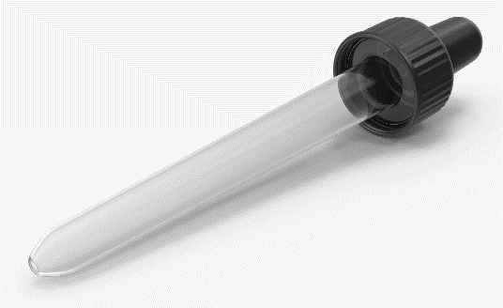
Data Cleansing

Slide 12
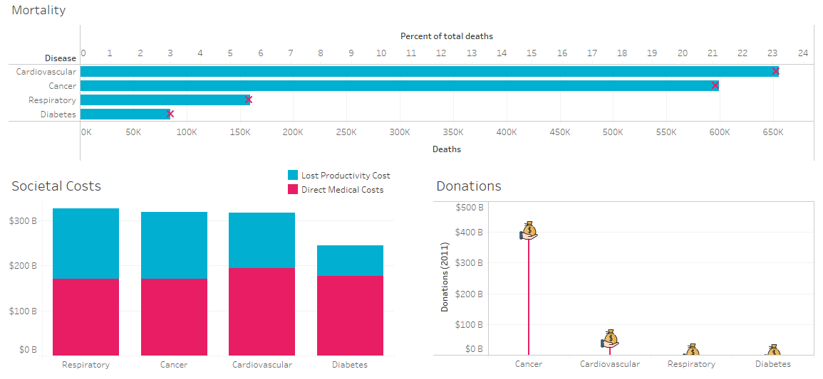
Data Exploration - Top 4 diseases & their impact on society

Slide 13
Data Exploration

Slide 14
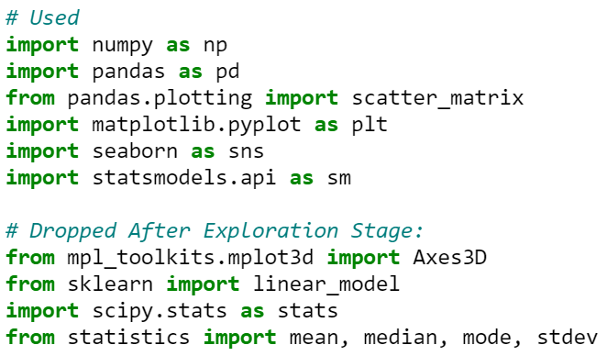
Coding
Answer for Defined Framed Problem Statement will require Multiple Linear Regression Analysis, therefore, Jupyter Notebooks to be used.
Libraries:
Provided richer OLS outputs that were well documented and described than sklearn

Slide 15
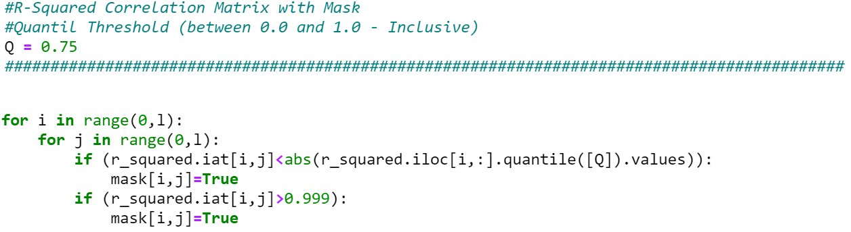
Coding
Filters at the top of each code block to ease data navigation and exploration.
Ex 1.
Ex 2.

Slide 16
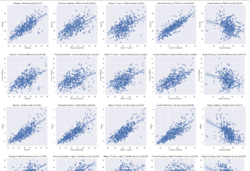
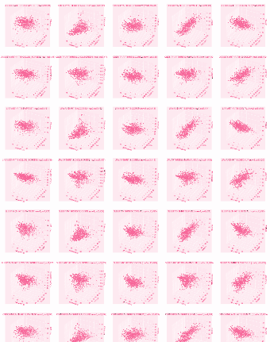
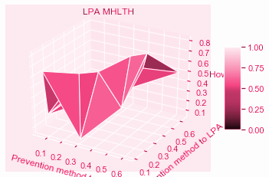
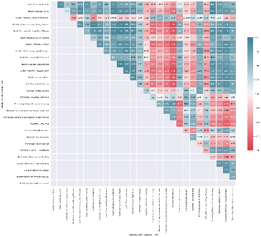
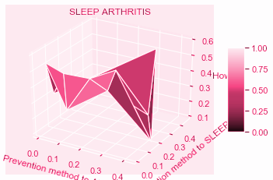
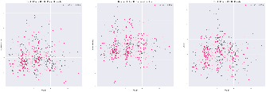
Data Exploration
Smart plots that highlight data potential and key information.
Used Dropped after exploration
Contrasting Aesthetic Colors
Contrasting Aesthetic Colors
Quick Navigation
Masks
Residual Plots (heteroscedasticity)

Slide 17
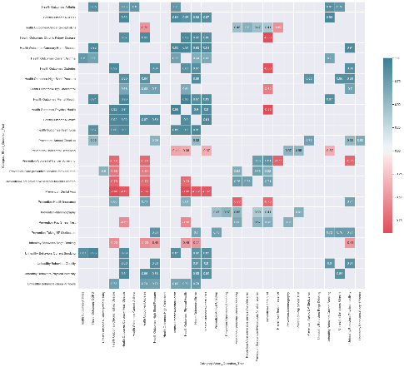
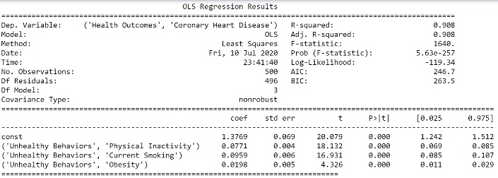
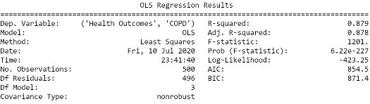
Data Exploration
Smart Masks (75th quartile and above, Top Contributing Factor/Correlations)
Contrasting Aesthetic Coors

Slide 18
Interpretation of the Analysis

Slide 19

Limitations of the Analysis
Correlation versus causation
Critical missing variables
Socioeconomic factors
Demographic information
Cross-sectional versus longitudinal

Slide 20
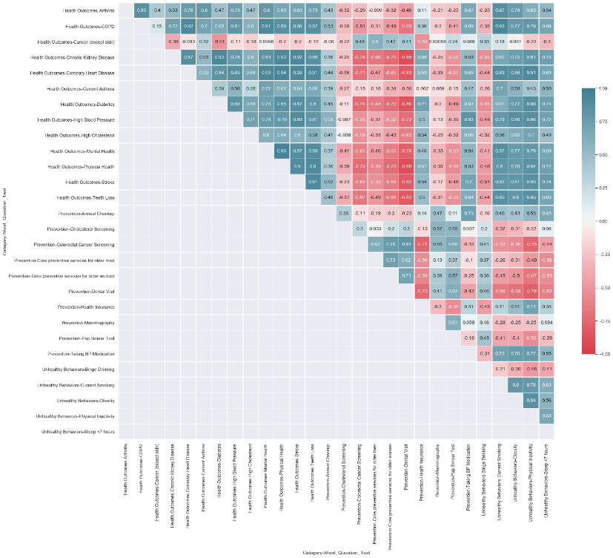
High Correlation between
Negative Health Outcomes

Slide 21
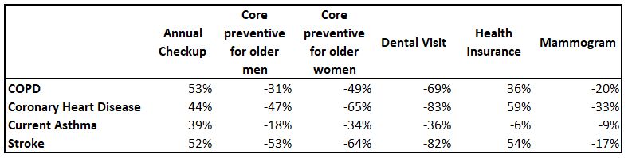
Preventative Measures not as Highly Correlated with Disease

Slide 22
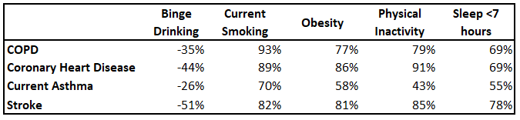
Unhealthy Behaviours are Highly Correlated with Disease

Slide 23
Good Fit Regression Model with High R-Squared Value
=========================================================================================================
Dep. Variable: ('Health Outcomes', 'Coronary Heart Disease') R-squared: 0.908
Model: OLS Adj. R-squared: 0.908
Method: Least Squares F-statistic: 1640.
Date: Fri, 10 Jul 2020 Prob (F-statistic): 5.63e-257
Time: 14:29:10 Log-Likelihood: -119.34
No. Observations: 500 AIC: 246.7
Df Residuals: 496 BIC: 263.5
Df Model: 3
Covariance Type: nonrobust
=====================================================================================================
coef std err t P>|t| [0.025 0.975]
------------------------------------------------------------------------------------------------------------------
const 1.3769 0.069 20.079 0.000 1.242 1.512
('Unhealthy Behaviors', 'Physical Inactivity') 0.0771 0.004 18.132 0.000 0.069 0.085
('Unhealthy Behaviors', 'Current Smoking') 0.0959 0.006 16.931 0.000 0.085 0.107
('Unhealthy Behaviors', 'Obesity') 0.0198 0.005 4.326 0.000 0.011 0.029
==============================================================================

Slide 24
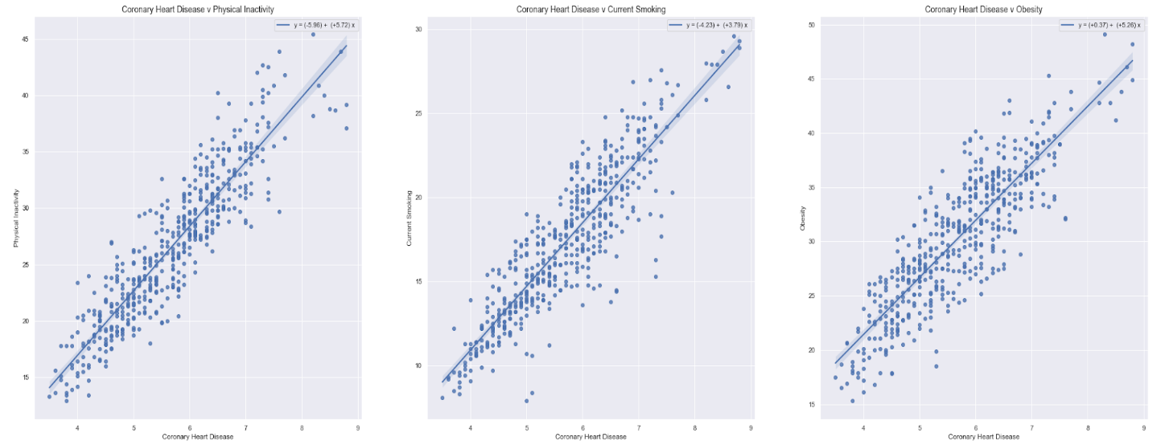
Linear Relationships = Model Fit
Coronary Heart Disease
vs. Physical Inactivity
Coronary Heart Disease
vs. Current Smoking
Coronary Heart Disease
vs. Obesity

Slide 25
Interpreting the Regression
Coronary Heart Disease Regression Equation
Ŷ= 1.38 + 0.08(X1) + 0.10(X2) + 0.02(X3)
CHD(predicted) = 1.38 + 0.08(Physical Inactivity) + 0.10(Current Smoking) + 0.02(Obesity)
1% decrease in the rate of smoking = a .1% decrease in CHD
1% decrease in physical inactivity = a .08% decrease in CHD
1% decrease in obesity = a .02% decrease in CHD

Slide 26


A Regression for Good
Decreasing each of these factors by just 1 percentage point could lead to a .2% decrease in CHD
Approximate annual savings = $387M in direct health care costs and $247M in lost productivity - not to mention a great deal of human suffering.

Slide 27
Findings

Slide 28

Findings and Recommendations
Focus on donations for Coronary Heart Disease (CHD), given the high associated mortalities and direct medical costs as well as low charitable donations
Target interventions for unhealthy behaviours rather than preventative measures as they are more highly correlated to incidence of disease, focusing on:
Physical Inactivity - 1% reduction leads to a .08% decrease in CHD
Current Smoking - 1% reduction leads to a .1% decrease in CHD
Obesity - 1% reduction leads to a .08% decrease in CHD
Focusing on these unhealthy behaviours has the added advantage of reducing incidence of other diseases as well and leading to a healthier society.

Slide 29
Findings and Recommendations (contd.)
Example list of organizations that have targeted interventions for:
Physical Inactivity - National-level programs like National Coalition for Promoting Physical Activity (NCPPA), Kids in Parks, Trailnet’s Healthy, Active, & Vibrant Communities Initiative and state-level programs like Arkansas Healthy Employee Lifestyle Program etc.
Current Smoking - BeTobaccoFree, UCSF Center for Tobacco Control Research and Education, National Networks for Tobacco Control and Prevention etc.
Obesity - Obesity Action Coalition, National Institute for Children's Healthcare Quality, The Obesity Society etc.
A detailed study is needed to determine which specific organizations to select for funding

Slide 30

Cost/Benefit Analysis

Slide 31
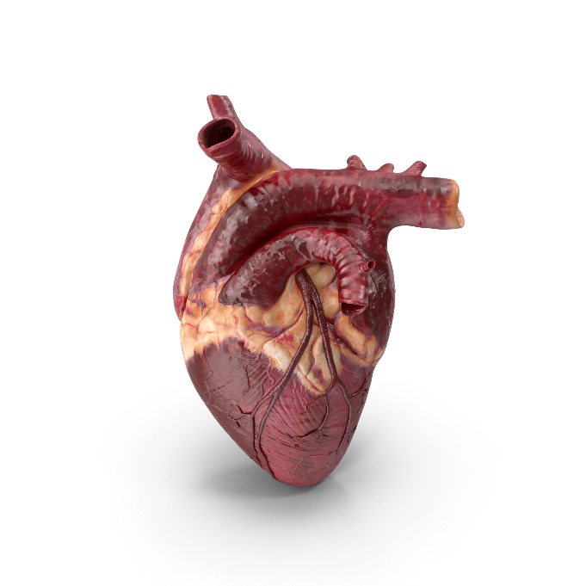
Some Stats first!
Once in 40 seconds
Someone has a heart attack in the USA
655,381
Deaths due to Heart disease in 2018
18.2 million
Adults age 20 & over with Heart disease

Slide 32

Associated Costs
$194 Billion
of direct medical costs due to heart disease
$124 Billion
of lost productivity due to heart disease
Only $54 million
donated to charities specifically for heart disease

Slide 33

Benefits of our recommendations
36,400
Annual reduction in number of people with heart disease*
$387 million
approx. savings in direct medical costs*
$247 million
approx. savings in lost productivity costs*
* with 1% reduction each in Inactivity, Smoking, Obesity

Slide 34
Conclusion
Physical inactivity, Current smoking and Obesity are the key factors contributing to the incidence of Coronary Heart Disease.
We recommend donating to health charities / research organizations that have intervention programmes targeting these unhealthy behaviours.

Slide 35

Thank you

Slide 36
Citations
500 Cities: Local Data for Better Health, 2016 release, Data.gov, Centers for Disease Control and Prevention, Retrieved June 19, 2020 from https://catalog.data.gov/dataset/500-cities-local-data-for-better-health-2016-release-3f265
Beaton, Thomas. Top 10 Most Expensive Chronic Diseases for Healthcare Payers, Health Payer Intelligence, Health Payer Intelligence, Retrieved June 19, 2020 from https://healthpayerintelligence.com/news/top-10-most-expensive-chronic-diseases-for-healthcare-payers
Programs And Interventions, CDC, Centers for Disease Control and Prevention, Retrieved June 28, 2020 from https://www.cdc.gov/500cities/programs-interventions.htm
Crude and Age-Adjusted Rate, Health.Mo, Missouri Department of Health and Senior Services, Retrieved June 30, 2020 from https://health.mo.gov/data/documentation/crude-aarate.php
Levine S, Malone E, Lekiachvili A, Briss P. Health Care Industry Insights: Why the Use of Preventive Services Is Still Low. Prev Chronic Dis 2019;16:180625. DOI: http://dx.doi.org/10.5888/pcd16.180625 from https://www.cdc.gov/pcd/issues/2019/18_0625.htm
Belluz, Julia. The truth about the Ice Bucket Challenge: Viral memes shouldn't dictate our charitable giving, Vox.com, Vox, Retrieved June 30, 2020 from https://www.vox.com/2014/8/20/6040435/als-ice-bucket-challenge-and-why-we-give-to-charity-donate
ALS Association, Alsa.org, Who Gets ALS?, Retrieved June 29, 2020 from http://webco.alsa.org/site/PageServer/?pagename=CO_1_WhoGets.html#:~:text=Approximately%205%2C000%20people%20in%20the,ALS%20at%20any%20given%20time

Slide 37
Citations
Fay, Bill. Hospital and Surgery Costs, Debt.org, America's Debt Help Organization, Retrieved June 28, 2020 from https://www.debt.org/medical/hospital-surgery-costs/
Leonhardt, Megan. Become Debt-Free, CNBC, CNBC Make It, Retrieved June 29, 2020 from https://www.cnbc.com/2020/02/13/one-third-of-american-workers-have-medical-debt-and-most-default.html
Survey: 79 Million Americans Have Problems with Medical Bills or Debt, Common Wealth Fund, The Commonwealth Fund Publication, Retrieved June 28, 202 from https://www.commonwealthfund.org/publications/newsletter-article/survey-79-million-americans-have-problems-medical-bills-or-debt#:~:text=In%20fact%2C%2041%20percent%20of,medical%20bill%20or%20debt%20problems.
Beaton, Thomas. Top 10 Most Expensive Chronic Diseases for Healthcare Payers, Health Payer Intelligence, Health Payer Intelligence, Retrieved June 19, 2020 from https://healthpayerintelligence.com/news/top-10-most-expensive-chronic-diseases-for-healthcare-payers
Shaw KM, Theis KA, Self-Brown S, Roblin DW, Barker L. Chronic Disease Disparities by County Economic Status and Metropolitan Classification, Behavioral Risk Factor Surveillance System, 2013. Prev Chronic Dis 2016;13:160088. DOI: http://dx.doi.org/10.5888/pcd13.160088 from https://www.cdc.gov/pcd/issues/2016/16_0088.htm#tables
Charitable Giving Statistics, Nptrust.org, National Philanthropic Trust, Retrieved June 30, 2020 from https://www.nptrust.org/philanthropic-resources/charitable-giving-statistics/#:~:text=General%20Philanthropy,a%200.7%25%20increase%20from%202017.&text=Corporate%20giving%20in%202018%20increased,a%205.4%25%20increase%20from%202017.&text=Foundation%20giving%20in%202018%20increased,a%207.3%25%20increase%20from%202017.

